Slide 1
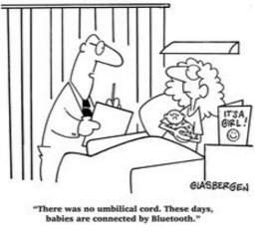
Data Transfer
Data Transfer: Interviewers (sender) >> Bluetooth >> Supervisor (receiver) >> Dropbox >> Central Office

Slide 2
What? Why? When? Who? How?
What?
Why?
When?
Who?
How?
Submitting data to the supervisor
Constantly backup data, check on progress
At least once per day (the more the better!)
Supervisors, Interviewers
Bluetooth

Slide 3
Fieldwork Flow – Assign Households
Arrive in cluster, Identify households
Interviewers carry out module interviews, collect height/weight
Supervisor assigns households
Interviewers send data to supervisor
Interview HHs, identify eligible individuals
Team resolves structural problems
Interviewer A assigns modules to Interviewer B
Supervisor submits data to central office
Notes:
Quick look at the flow of field work from start to finish in a cluster – training will refer back to this chart regularly

Slide 4

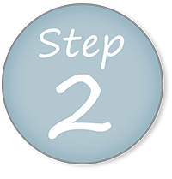
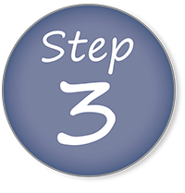
Steps in Data Transfer/Submitting
Supervisor prepares to receive data from interviewers
Interviewers send data to supervisor
Supervisor reviews structural messages and progress report

Slide 5
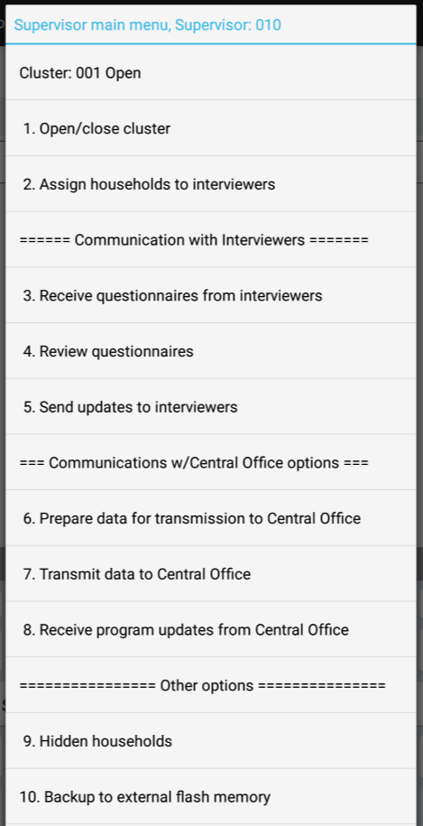
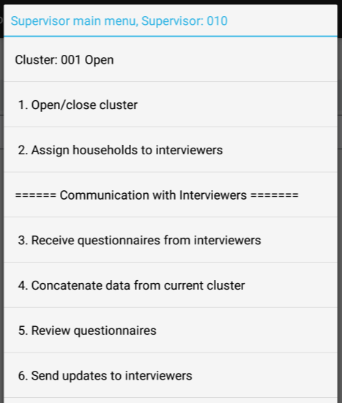
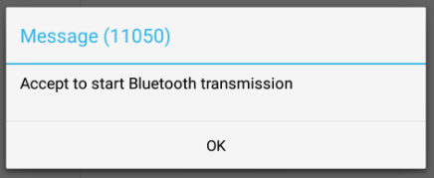
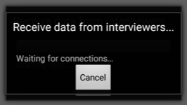
Supervisor prepares to receive data
From supervisor main menu, choose option 3:
System begins searching for Bluetooth connection with interviewers…

Slide 6
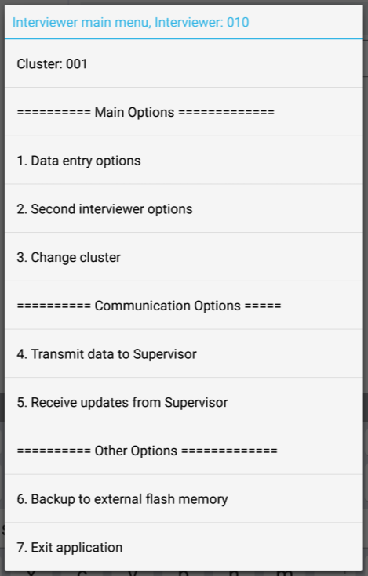
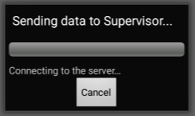
Interviewers send data to Supervisor
From interviewer main menu, choose option 4:
System begins searching for Bluetooth connection with supervisor…
Notes:
If successful, “Transmission successful” message will appear (just as in assignment of households).

Slide 7
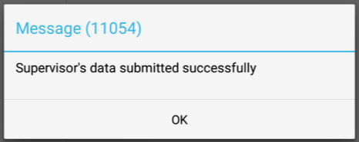
Supervisor sends data to Supervisor
From interviewer main menu, choose option 4:
Because supervisor is sending data to themselves, no Bluetooth connection needed!
Notes:
If supervisors carried out any interviews, they too must “transmit data to Supervisor”. Basically this copies the data from the interviewer folders to the supervisor folders – from one role to the other role!

Slide 8


Supervisor review of work
After all interviewers have submitted data, choose option 4 from supervisor main menu:
Notes:
After transmission of data has been successful with all interviewers (including the supervisor), the supervisor should review progress of work and can review questionnaires individually.

Slide 9
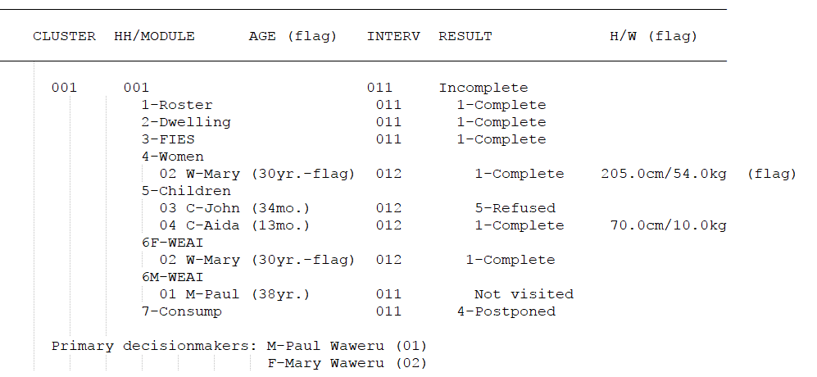
Check structure and progress
A listing of all work started will appear:
Notes:
This is an example of one household – supervisor will see all households!
Listing checks to see that what was supposed to be done was done, and what shouldn’t be done, hasn’t been done
Point out components of listing – cluster, household/module number, interviewer number, result code, number of visits, H/W and age flags, PDMs

Slide 10
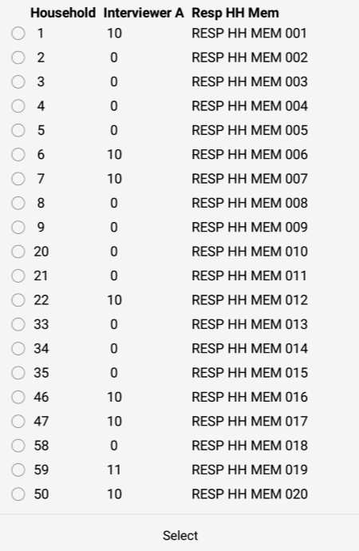
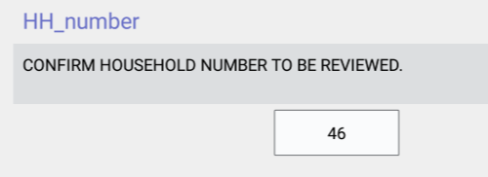
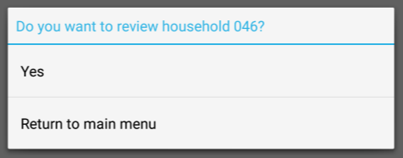
Option to review households
Questionnaire will open and supervisor can review
Notes:
Pick household supervisor wants to review (all assigned will appear). No need to review everything that comes in – just those with flags or issues during closing clusters or structure and progress report

Slide 11

Practice time
Each interviewer (one at a time) should send their data to their supervisor.

